Slide 1
File Handling in C

Slide 2
Goals
By the end of this unit you should understand …
… how to open a file to write to it.
… how to open a file to read from it.
… how to open a file to append data to it.
… how to read strings from a file.
… how to write strings to a file.

Slide 3
What is a File?
A file is a collection of related data that a computers treats as a single unit.
Computers store files to secondary storage so that the contents of files remain intact when a computer shuts down.
When a computer reads a file, it copies the file from the storage device to memory; when it writes to a file, it transfers data from memory to the storage device.

Slide 4
Buffers
A buffer is a “special work area” that holds data as the computer transfers them to/from memory.
Buffers help to synchronize data to the physical devices with the program.
The physical requirements of the devices can deliver more data for input than a program can use at any one time. The buffer handles the overflow data until a program can use it.
Moreover, the buffer also holds data until it is efficient to write that data to the storage device for output.

Slide 5
File Information Table
A program requires several pieces of information about a file, including the name the OS uses for it, the position of the current character, etc.
C uses a structure called FILE (defined in stdio.h) to store the attributes of a file.

Slide 6
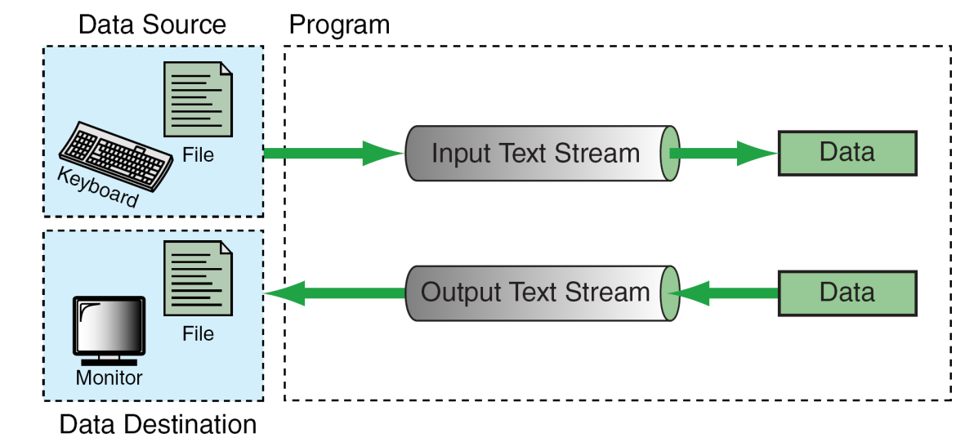
Streams
In C, we input/output data using streams. We can associate a stream with a device (i.e. the terminal) or with a file.
C supports two types of files
  Text Stream Files
  Binary Stream Files
from Figure 7-1 in Forouzan & Gilberg, p. 395

Slide 7
Text Streams & Binary Streams
Text streams consist of sequential characters divided into lines. Each line terminates with the newline character (\n).
Binary streams consist of data values such as integers, floats or complex data types, “using their memory representation.”
Today, we’ll concentrate solely on text streams …

Slide 8
Files & Streams
A file is an “independent entity” with a name recorded by the operating system.
A stream is created by a program.
To work with a file, we must associate our stream name with the file name recorded by the OS.

Slide 9
Steps in Processing a File
Create the stream via a pointer variable using the FILE structure:
FILE *spData;
Open the file, associating the stream name with the file name.
Read or write the data.
Close the file.

Slide 10
System-Created Streams
C automatically creates three streams that it opens and closes automatically for us in order to communicate with the terminal:
  stdin
  stdout
  stderr
We cannot re-declare these streams in our programs.

Slide 11
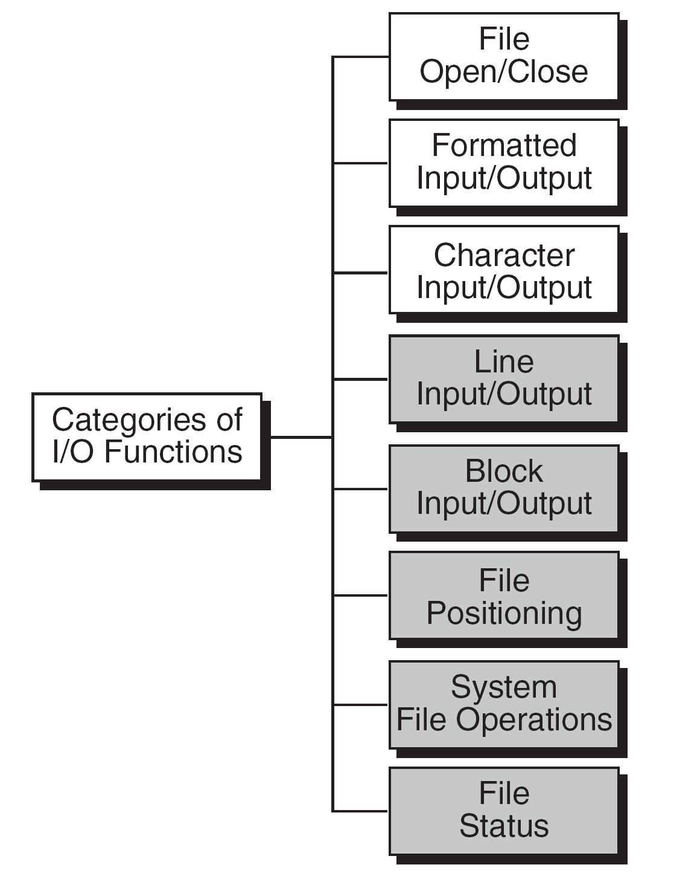
Standard I/O Functions in C
from Figure 7-2 in Forouzan & Gilberg, p. 398

Slide 12
File Open
The file open function (fopen) serves two purposes:
  It makes the connection between the physical file and the stream.
  It creates “a program file structure to store the information” C needs to process the file.
Syntax:
fopen(“filename”, “mode”);

Slide 13
More On fopen
The file mode tells C how the program will use the file.
The filename indicates the system name and location for the file.
We assign the return value of fopen to our pointer variable:
  spData = fopen(“MYFILE.DAT”, “w”);
  spData = fopen(“A:\\MYFILE.DAT”, “w”);

Slide 14
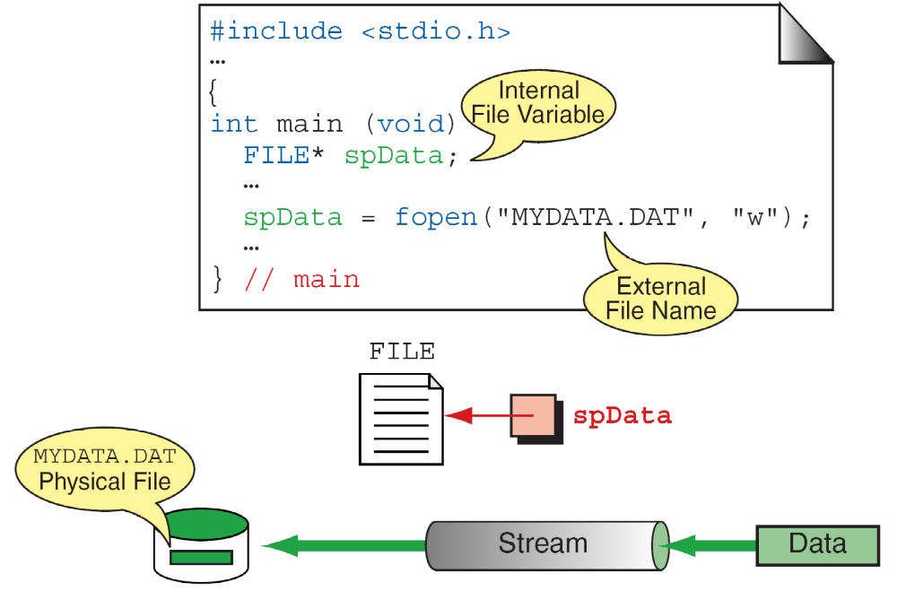
More On fopen
from Figure 7-3 in Forouzan & Gilberg, p. 399

Slide 15
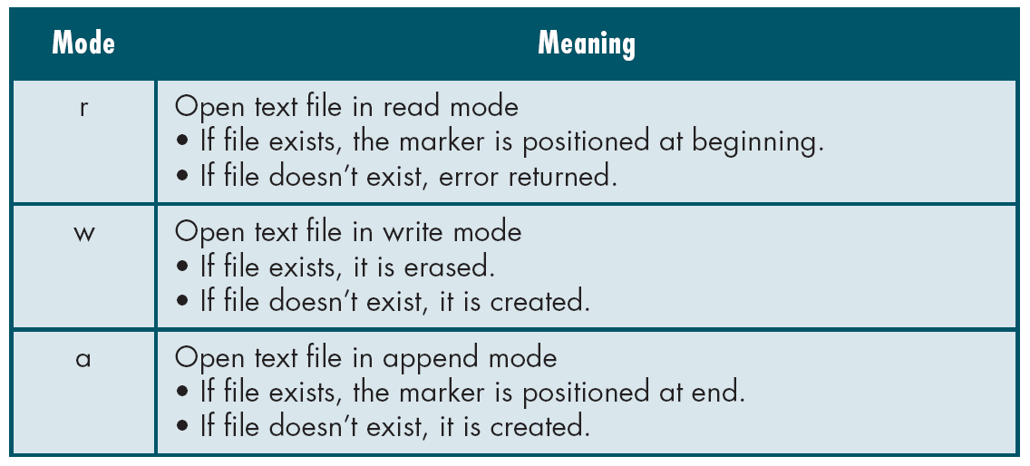
File Open Modes
from Table 7-1 in Forouzan & Gilberg, p. 400

Slide 16
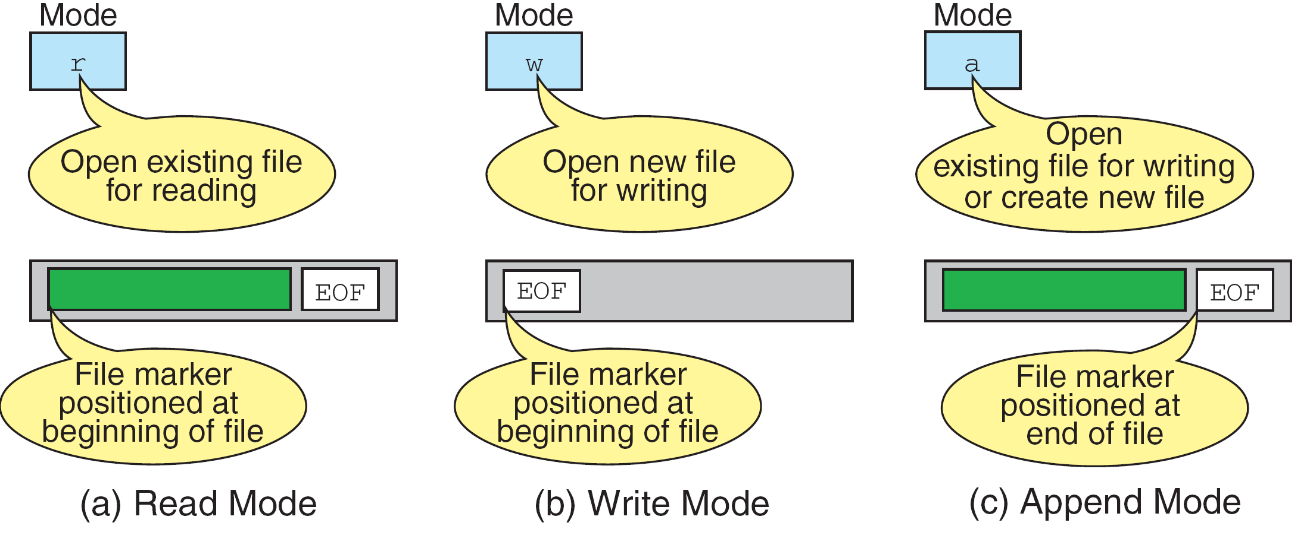
More on File Open Modes
from Figure 7-4 in Forouzan & Gilberg, p. 401

Slide 17
Closing a File
When we finish with a mode, we need to close the file before ending the program or beginning another mode with that same file.
To close a file, we use fclose and the pointer variable:
fclose(spData);

Slide 18
Code Example of fopen/fclose
Example:
n305UsingFopenFclose.c

Slide 19
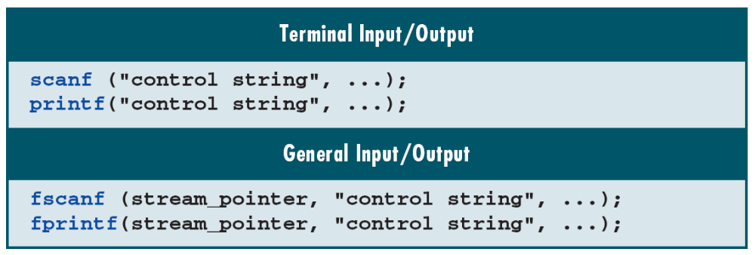
Additional I/O Functions
from Table 7-2 in Forouzan & Gilberg, p. 403

Slide 20
Whitespace in
Format Control Strings
For input, one or more whitespace characters in a format control string cause C to discard leading whitespace characters.
For output, C copies whitespace characters in a format control string to the output stream.

Slide 21
Text in Format Control Strings
For input, text must match exactly in the format control string to that of the input stream.
For output, C copies text in the format control string to the output stream.

Slide 22
Conversion Specifications
from Figure 7-5 in Forouzan & Gilberg, p. 406

Slide 23
Conversion Specifications
“The number, order, and type of the conversion specifications must match the number, order, and type of the parameters in the list. Otherwise, the result will be unpredictable and may terminate the input/output function.”

Slide 24
Input Data Formatting
fscanf/scanf will process input characters until one of the following happens:
  The function reaches the EOF indicator.
  The function encounters an inappropriate character.
  The function reads in a number of characters explicitly programmed as a maximum width field.

Slide 25
fscanf/scanf Flag & Width
We use only one flag with fscanf/scanf – the supression flag (*), which tells the function to read input and then discard it:
scanf(“%d %*c %f”, &x, &y);
The width is an optional modifier that with specify the maximum width for input (in characters):
scanf(“%3d%2d%4d”, &ssn1, &ssn2, &ssn3);

Slide 26
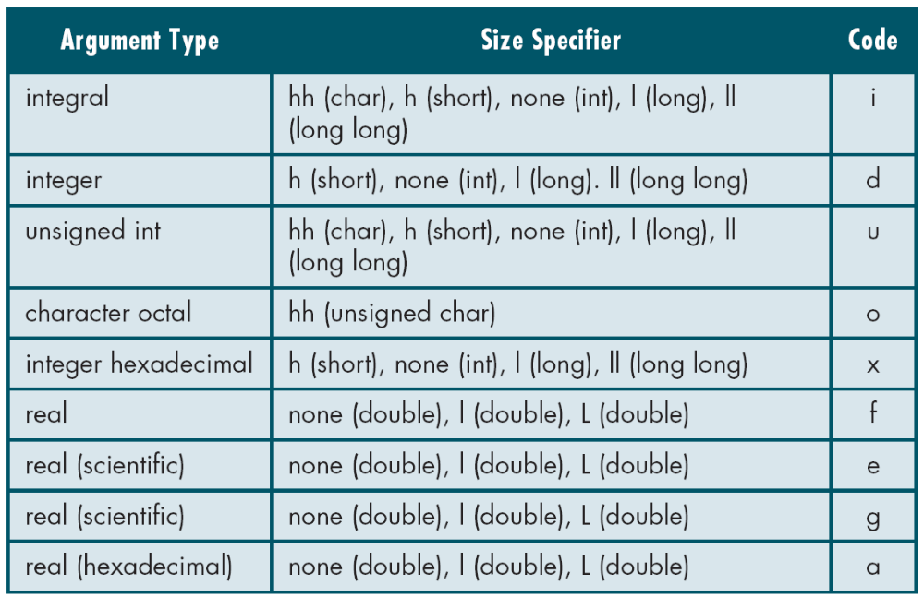
Size & Conversion Codes
from Table 7-3 in Forouzan & Gilberg, p. 407

Slide 27
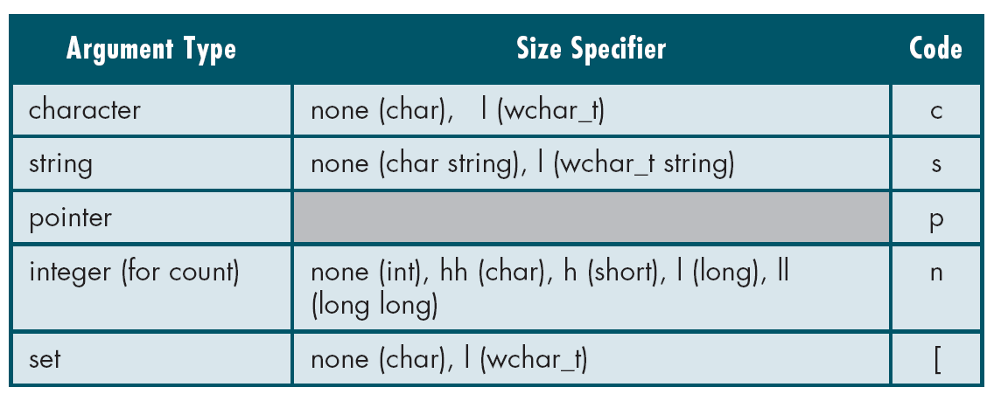
Size & Conversion Codes
from Table 7-3 in Forouzan & Gilberg, p. 408

Slide 28
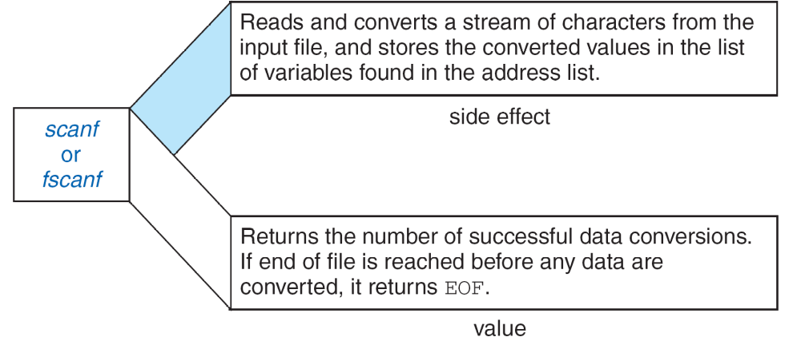
Side Effect & Value of fscanf/scanf
from Figure 7-6 in Forouzan & Gilberg, p. 410

Slide 29
Input Stream Issues
There is always a return character at the end of an input stream due to the fact that C buffers the stream.
fscanf/scanf functions leave the return character in the buffer. To force a discard of the character, begin your format control string with a space character.
fscanf/scanf terminate when all specified operations in the control string complete; if the control string ends with a whitespace character, fscanf/scanf continue (they terminate only with a non-whitespace control string).

Slide 30
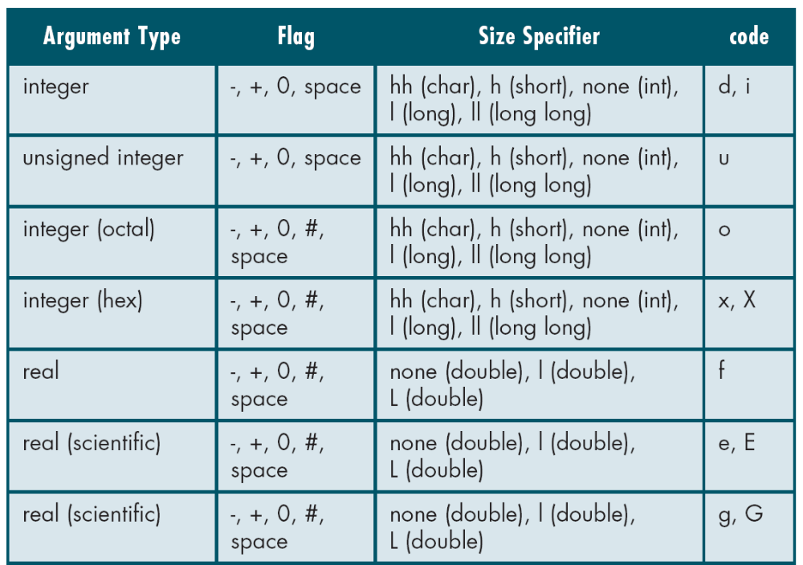
fprintf/printf Flags,
Sizes & Conversion Codes
from Table 7-4 in Forouzan & Gilberg, p. 419

Slide 31
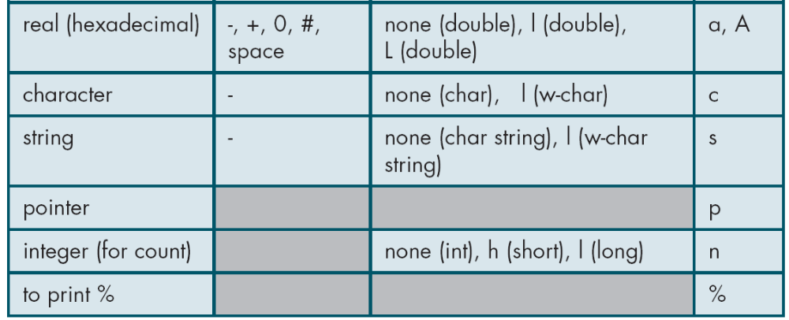
fprintf/printf Flags,
Sizes & Conversion Codes
from Table 7-4 in Forouzan & Gilberg, p. 419

Slide 32
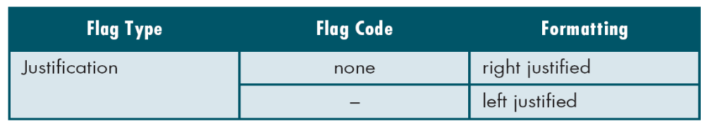
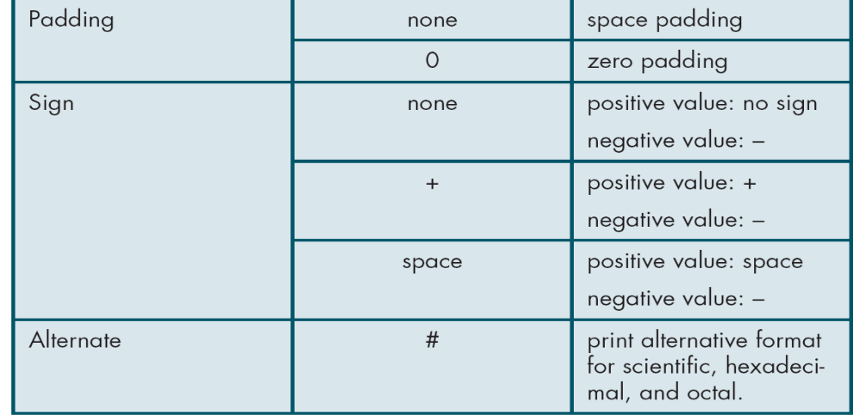
fprintf/printf Output Flags
from Table 7-5 in Forouzan & Gilberg, p. 419-420

Slide 33
Width & Precision in Output
Width for output specifies a minimum width. If data are wider, C will print all the data.
We specify precision with a period followed by an integer:
  For integers, precision specifies the minimum number of digits to print (incl. leading zeroes).
  For floating-point numbers, precision specifies the number of digits to print to the right of the floating point.
  For scientific numbers (g and G), precision specifies how many significant digits to print.

Slide 34
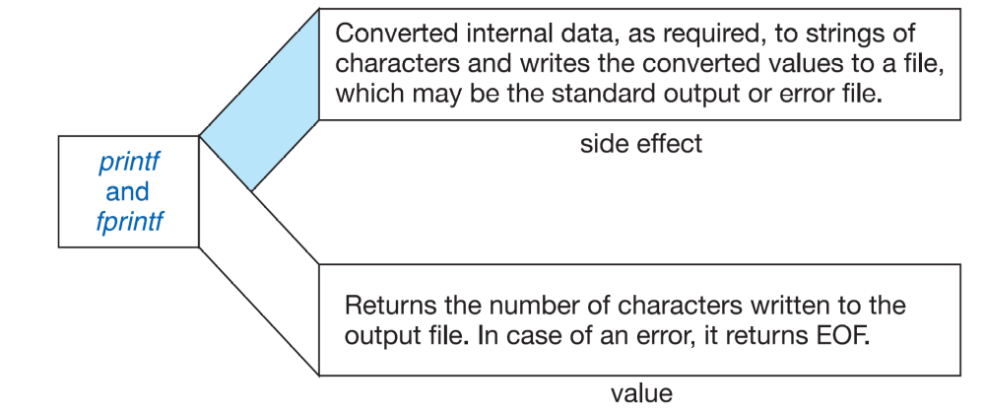
Output Side Effect & Value
from Figure 7-11 in Forouzan & Gilberg, p. 423

Slide 35
Code Example of fscanf
Example:
n305UsingFscanf.c

Slide 36
Code Example of fprintf
Example:
n305UsingFprintf.c

Slide 37
Code Example of Append Mode
Example:
n305AppendMode.c

Slide 38
Code Example of File Handling
Example:
n305StudentGrades.c

Slide 39
Code Example of String Input
Example:
n305StringInput.c

Slide 40
Code Example of String Output
Example:
n305StringOutput.c

Slide 41
Questions?

Slide 42
Resources
Forouzan, Behrouz & Richard Gilberg, Computer Science: A Structured Programming Approach Using C. Thomson Course Technology: 2007.

